Slide 1
Data Structures

Slide 2
Agenda
Implementation of Graphs
Breadth First Search(BFS)
Implementation of BFS
Depth First Search(DFS)
Implementation of DFS

Slide 3
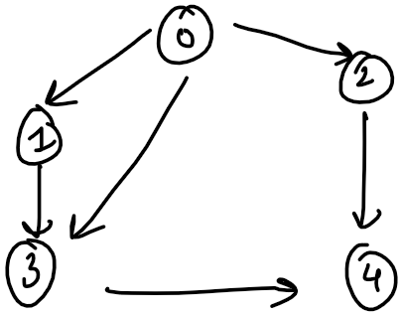
Implementation of Graphs
Adjacency List Implementation using Array and LL

Slide 4
Implementation of Graphs
Adjacency List Implementation using Set & Map

Slide 5
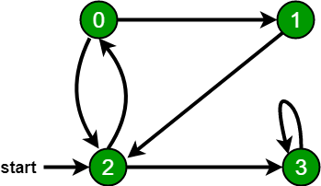
Breadth First Search(BFS)
Breadth First Traversal (or Search) for a graph is similar to Breadth First Traversal of a tree. The only catch here is, unlike trees, graphs may contain cycles, so we may come to the same node again.
For example, in the following graph, we start traversal from vertex 2. When we come to vertex 0, we look for all adjacent vertices of it. 2 is also an adjacent vertex of 0. It will become a non-terminating process.
Breadth-first search (BFS) is an algorithm for traversing or searching tree or graph data structures. It starts at the tree root (or some arbitrary node of a graph, sometimes referred to as a 'search key), and explores all of the neighbor nodes at the present depth prior to moving on to the nodes at the next depth level.

Slide 6
Breadth First Search(BFS)
Breadth First Traversal (or Search) for a graph is similar to Breadth First Traversal of a tree. The only catch here is, unlike trees, graphs may contain cycles, so we may come to the same node again.
To avoid processing a node more than once, we use a boolean visited array in case of List Representation or a HashSet in case of Set Representation.

Slide 7
BFS of our Graph

Slide 8
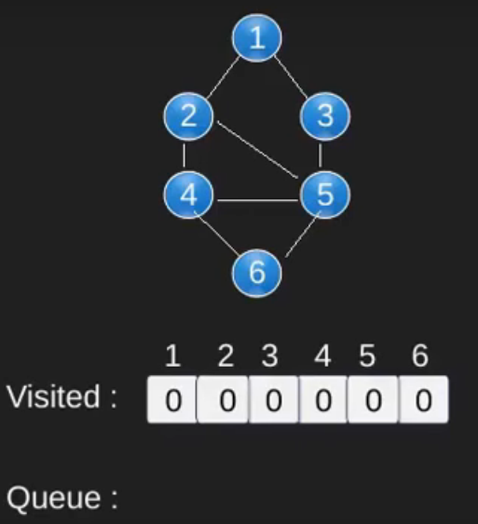
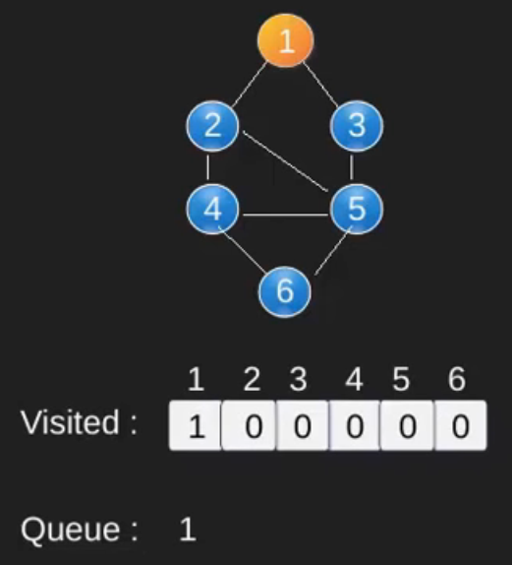
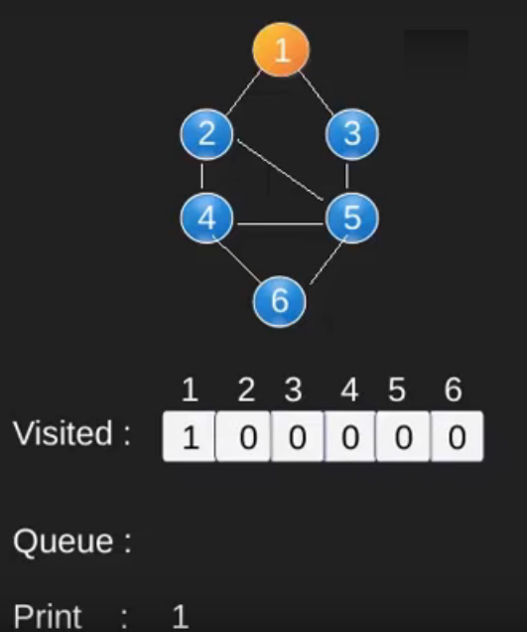
Breadth First Search(BFS)
An Example

Slide 9
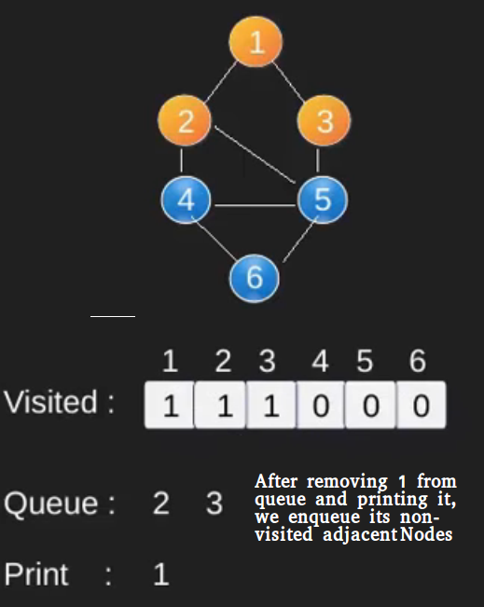
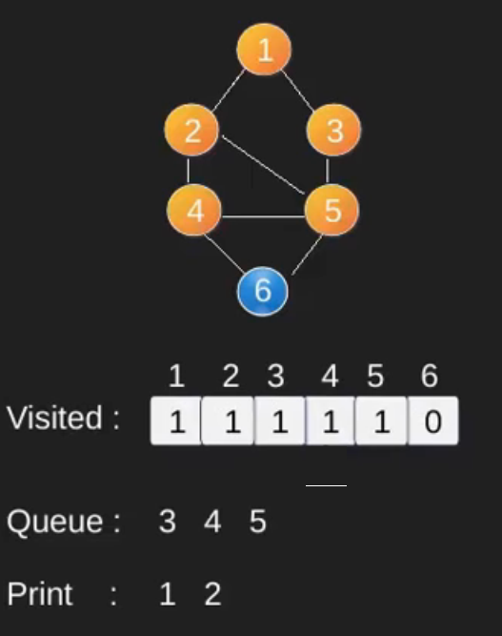
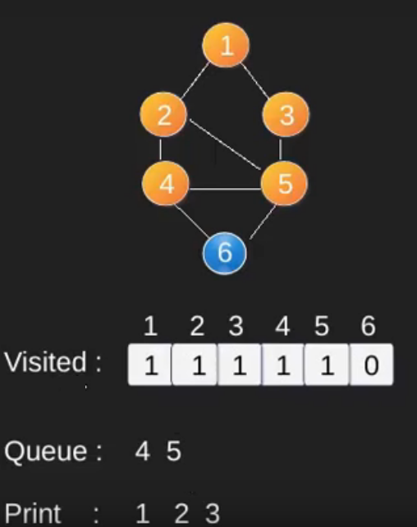
Breadth First Search(BFS)
An Example (Continued)

Slide 10
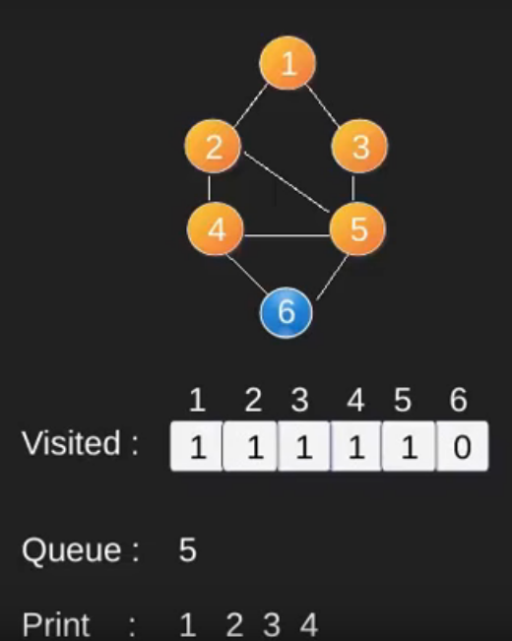
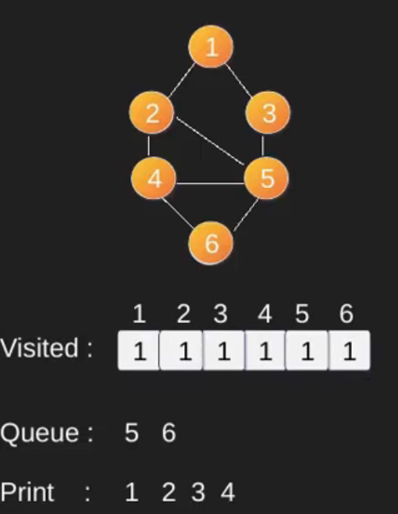
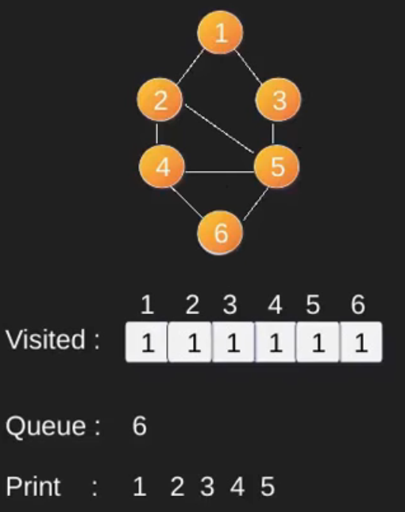
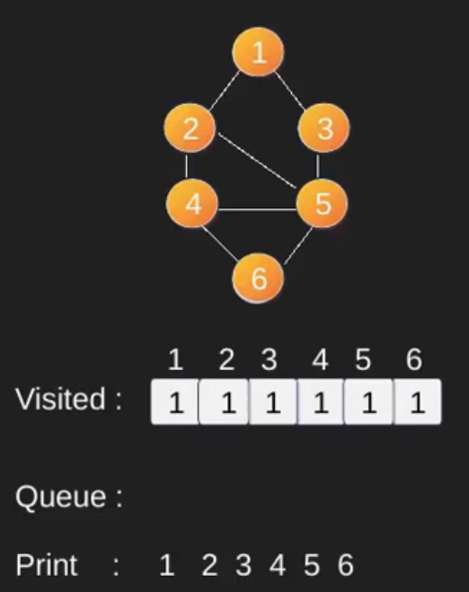
Breadth First Search(BFS)
An Example (Continued)

Slide 11
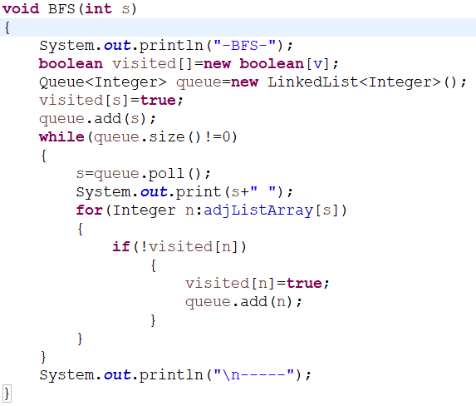
Implementation of BFS
BFS Implementation using Visited Array

Slide 12
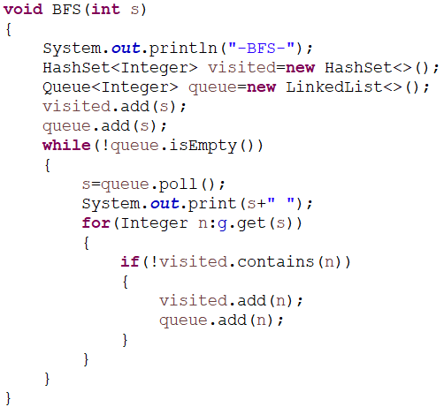
Implementation of BFS
BFS Implementation using Visited Set

Slide 14
Depth First Search(DFS)
Depth First Traversal (or Search) for a graph is similar to Depth First Traversal of a tree. The only catch here is, unlike trees, graphs may contain cycles, so we may come to the same node again.
For example, in the following graph, we start traversal from vertex 2. When we come to vertex 0, we look for all adjacent vertices of it. 2 is also an adjacent vertex of 0. It will become a non-terminating process.
Depth-first search (DFS) is an algorithm for traversing or searching tree or graph data structures. The algorithm starts at the root node (selecting some arbitrary node as the root node in the case of a graph) and explores as far as possible along each branch before backtracking.

Slide 15
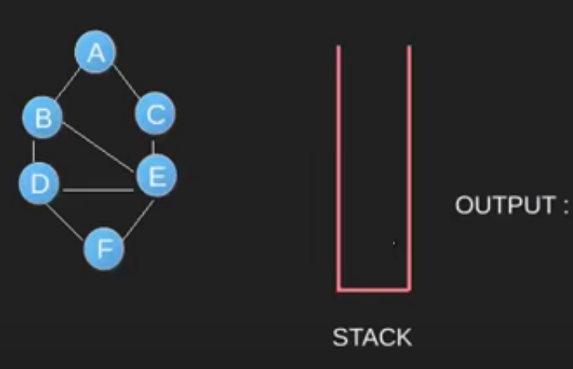
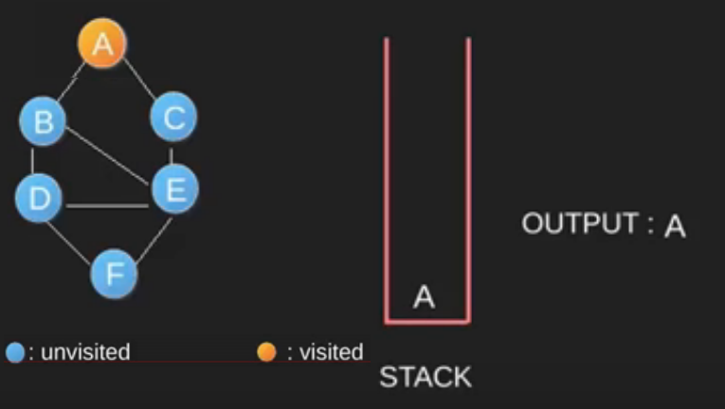
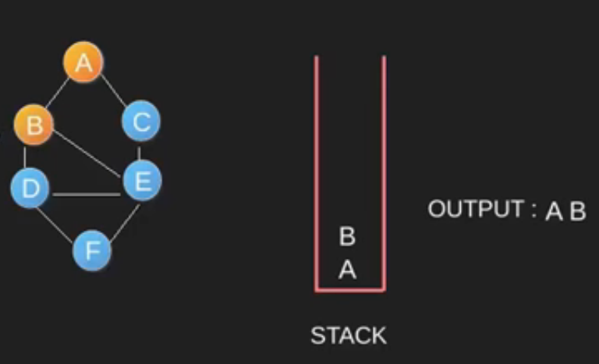
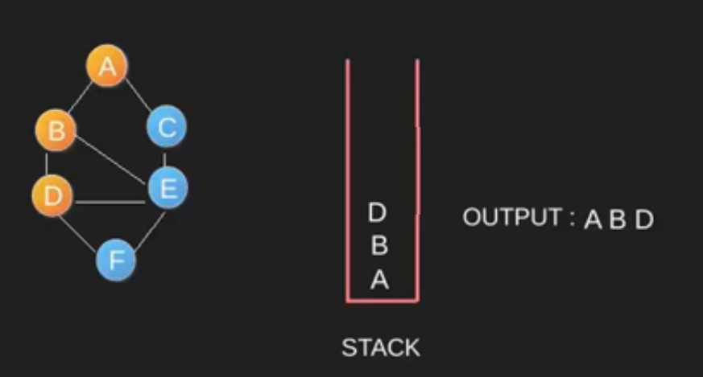
Depth First Search(DFS)
An Example

Slide 16
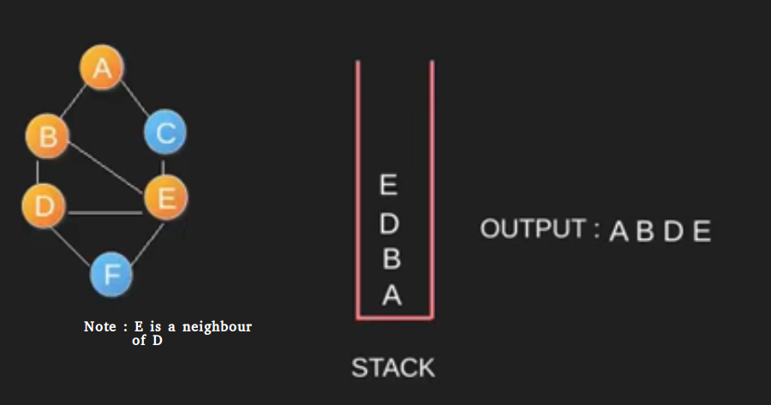
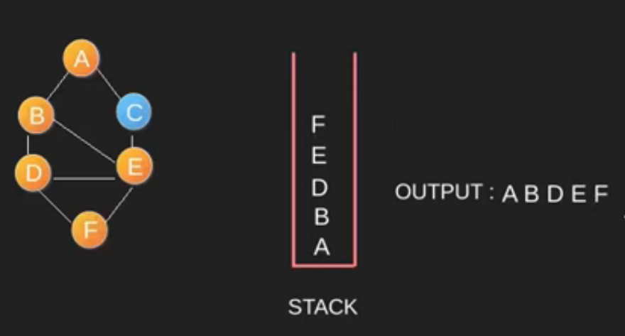
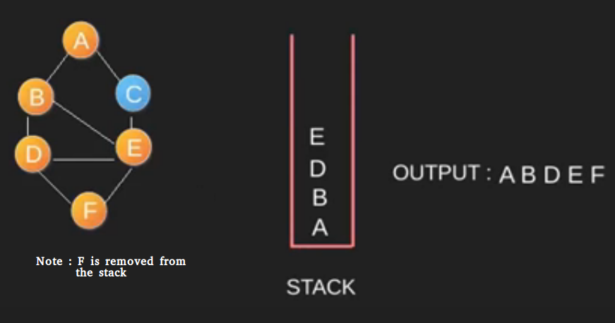
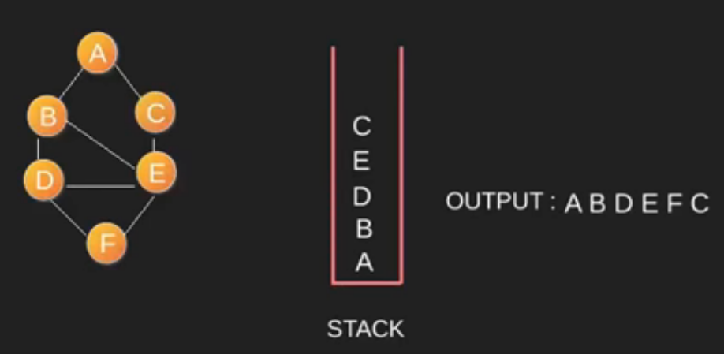
Depth First Search(DFS)
An Example (Continued)

Slide 17
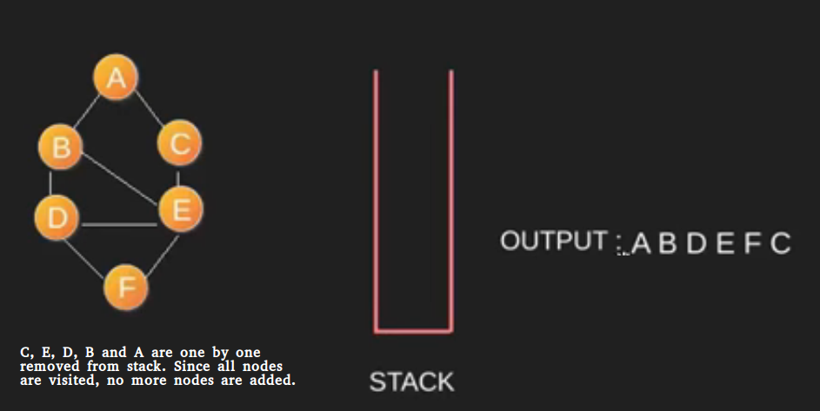
Depth First Search(DFS)
An Example (Continued)

Slide 18
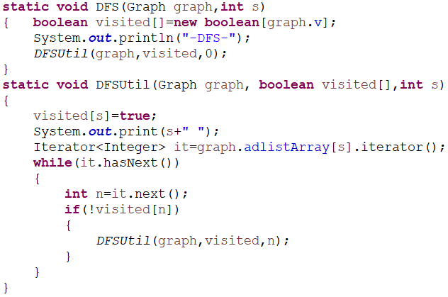
Implementation of DFS
DFS Implementation using Visited Array

Slide 19
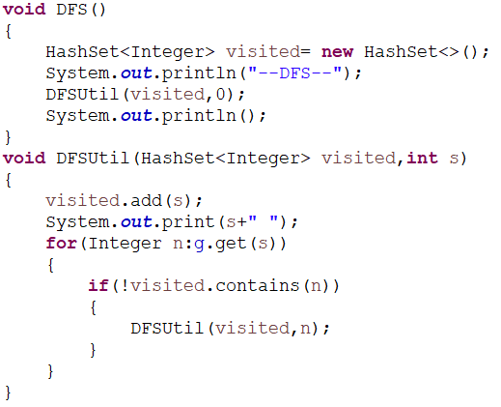
Implementation of DFS
DFS Implementation using Visited Set

Slide 20
DFS Overall

Slide 21
Connected Components
https://practice.geeksforgeeks.org/problems/number-of-provinces/1/

Slide 22
THANK YOU

